Slide 1
Does proximity to amenities impact the rental price of a property in Aberdeen?
By Alexandra Ungureanu

Slide 2
Introduction
Background:
I have been renting in Aberdeen, Scotland for nearly 9 years and one thing I could never fully comprehend was the rental price.
I would often find two properties in close proximity to each other, and which to me seemed to be fairly similar, but with very different asking prices.
Target audience:
My fellow renters in Aberdeen, Scotland

Slide 3
Data Sources
Rental properties available:
Data scraped from Aberdeen Solicitors Property Centre’s website as of 15th July 2020: https://www.aspc.co.uk/
446 properties in Aberdeen city
Foursquare amenities data:
Obtained on 6th August 2020
100 amenities in Aberdeen city

Slide 4
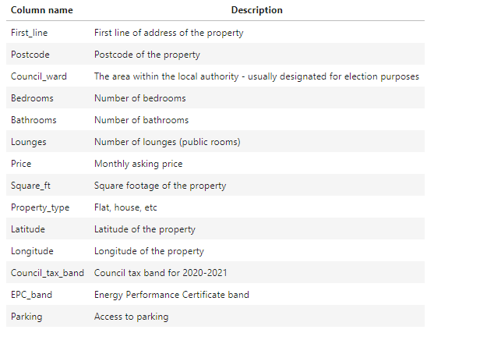
Data sources – properties dataframe columns explained

Slide 5
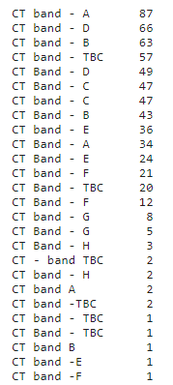
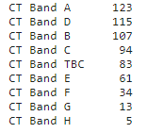
Data cleaning – Council Tax band
Before cleaning | After cleaning
The council tax band strings pulled from ASPC did not follow a consistent format and required further cleaning.
The before and after side table shows why this was required.

Slide 6
Data cleaning – handling null values
Number of properties with:
no council tax entry: 3;
no EPC entry: 1;
no square footage entry: 235;
council tax entry as TBC (To Be Confirmed): 74.
Solution:
Council tax band data: https://ecitizen.aberdeencity.gov.uk/publicaccesslive/selfservice/services/counciltax/bandsearch.htm
Square footage and EPC data: https://www.scottishepcregister.org.uk/CustomerFacingPortal/EPCPostcodeSearch
Method:
Manual – both website explicitly prohibit the use of a web scraper

Slide 7
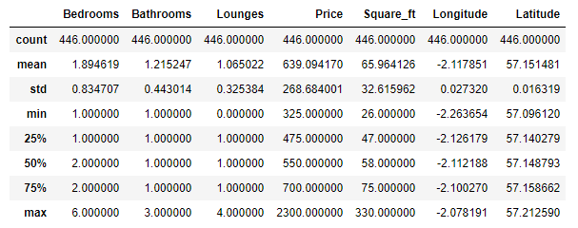
Exploratory data analysis
The average rental property in Aberdeen:
close to two bedrooms
one bathroom
one lounge
approximately 66 square meters of space
goes for £640 a month

Slide 8
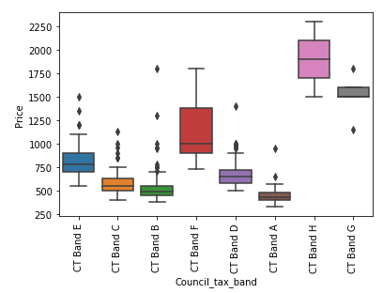
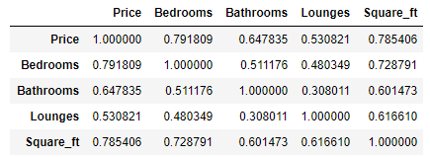
Analysis – correlation between property variables
Numerical variables
Categorical variable

Slide 9
Analysis – Kmeans clustering
3 clusters:
Cluster 1: 332 properties | avg 1.5 beds, 1 bath, 1 lounge | 54 sq m | £505 pm
Cluster 2: 129 properties | avg 2.5 beds, 1.5 baths, 1 lounge | 89 sqm | £831pm
Cluster 3: 19 properties | avg 3.7 beds, 2 baths, 1.7 lounges | 154 sqm | £1,580pm

Slide 10
Cluster observations
Cluster 1 vs Cluster 2:
Both minimums: 1 bed, 1 bath, no lounges.
8 sqm and £350 more on its asking price
Cluster 2 vs Cluster 3:
Cluster 3’s minimum = Cluster 2’s 1st quartile
2 beds, 1 bath, 1 lounge
9sqm less but £575 more on its asking price

Slide 11
Cluster visualisation – Folium map
The differences between, especially, 2nd and 3rd clusters are both interesting and confusing. Why would you pay £575 per month MORE for the same features in a smaller property?
The following slide’s map shows the 3 clusters positioned in Aberdeen city.

Slide 12
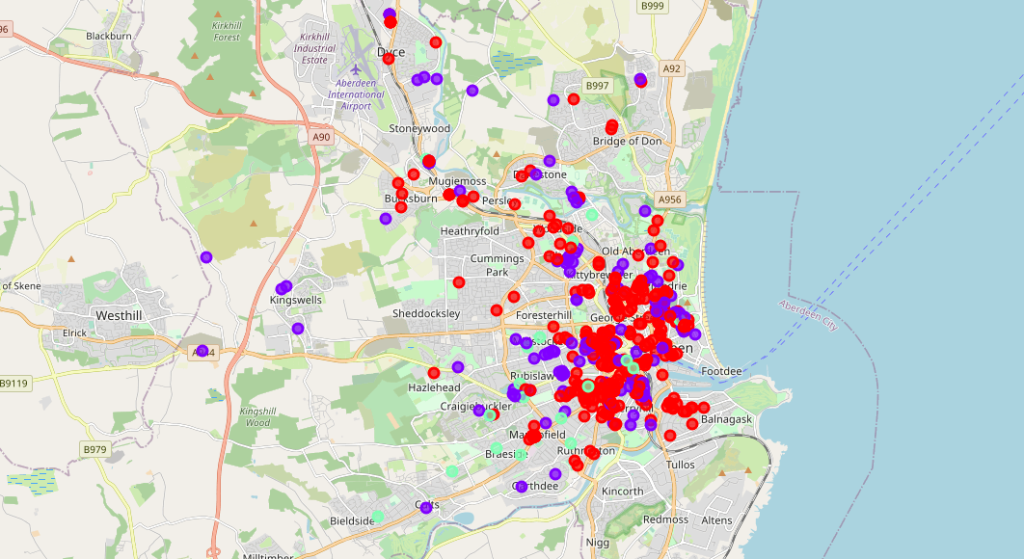

Slide 13
Cluster visualisation – Folium map explained
As can be seen, the third cluster (light green) properties tend to be spread towards the South – West and North.
For anyone who has lived in Aberdeen this makes sense as those locations are considered to be very desirable residential areas.
You are paying for location, not features.

Slide 14
Does proximity to amenities impact the price then?
Fourquare amenities (cafes, shops, etc): 100 in Aberdeen city
Folium map on the following slide to visualise their location and concentration (if any)

Slide 15
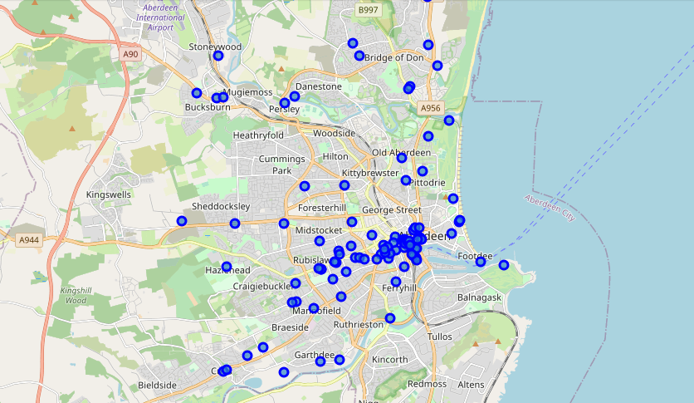

Slide 16
Comparison: Cluster map vs. amenities map
When looking at the concentration of amenities and their spread across Aberdeen it can be noticed that the vast majority are located in the city centre.
At the same time the first map shows a concentration of lower value properties (in red) in the same area.
The higher value properties (third cluster – light green) tend to move away from the amenities.

Slide 17
Conclusion
The analysis and maps show that proximity to amenities does not have weight in determining the rental price in Aberdeen.
If anything, it seems to negatively impact it as properties within the concentrated amenities area (the city centre) are on the lower value end of the market.

Slide 18
Thank you

